Slide 1
REAL ESTATE ANALYSIS
Data Analysis with Python using the ‘Real Estate Data Set’

Slide 2
Context
The Office of Policy and Management (OPM) oversees the compilation of real estate sales data.
This dataset encompasses all property transactions valued at $2,000 or more, occurring annually between
October 1st and September 30th. Each entry within the record comprises details such as town location,
property address, sale date, property classification (residential, apartment, commercial, industrial,
or vacant land), sale price, and property assessment value.

Slide 3
Problem Statement
Problem Statement: Investigating Property Assessment and Sales Data to Facilitate Well-Informed Decision-Making.

Slide 4
The dataset comprises a total of 997,213 records for each variable. The mean values for Assessed Value, Sale Amount, and Sales Ratio stand at $279,143.70, $391,151.20, and 10.45, respectively. The dataset spans nearly two decades, ranging from the minimum year of 2001 to the maximum year of 2020. Additionally, the date range extends from April 5, 1999, to September 30, 2021, indicating a broad timeframe for recorded transactions.
Serial Number | List Year | Date Recorded | Assessed Value | Sale Amount | Sales Ratio
count | 9.972130e+05 | 997213.000000 | 997213 | 9.972130e+05 | 9.972130e+05 | 9.972130e+05
mean | 4.311864e+05 | 2010.189829 | 2011-06-19 11:39:01.489330432 | 2.791437e+05 | 3.911512e+05 | 1.044637e+01
min | 0.000000e+00 | 2001.000000 | 1999-04-05 00:00:00 | 0.000000e+00 | 0.000000e+00 | 0.000000e+00
25% | 3.044400e+04 | 2004.000000 | 2005-07-25 00:00:00 | 8.760000e+04 | 1.400000e+05 | 4.867000e-01
50% | 7.030300e+04 | 2010.000000 | 2011-01-19 00:00:00 | 1.383900e+05 | 2.250000e+05 | 6.246000e-01
75% | 1.518780e+05 | 2016.000000 | 2017-04-05 00:00:00 | 2.255600e+05 | 3.650000e+05 | 7.852761e-01
max | 2.000500e+09 | 2020.000000 | 2021-09-30 00:00:00 | 8.815100e+08 | 5.000000e+09 | 1.226420e+06
std | 6.549219e+06 | 6.237877 | NaN | 1.670610e+06 | 5.347270e+06 | 1.890192e+03

Slide 5
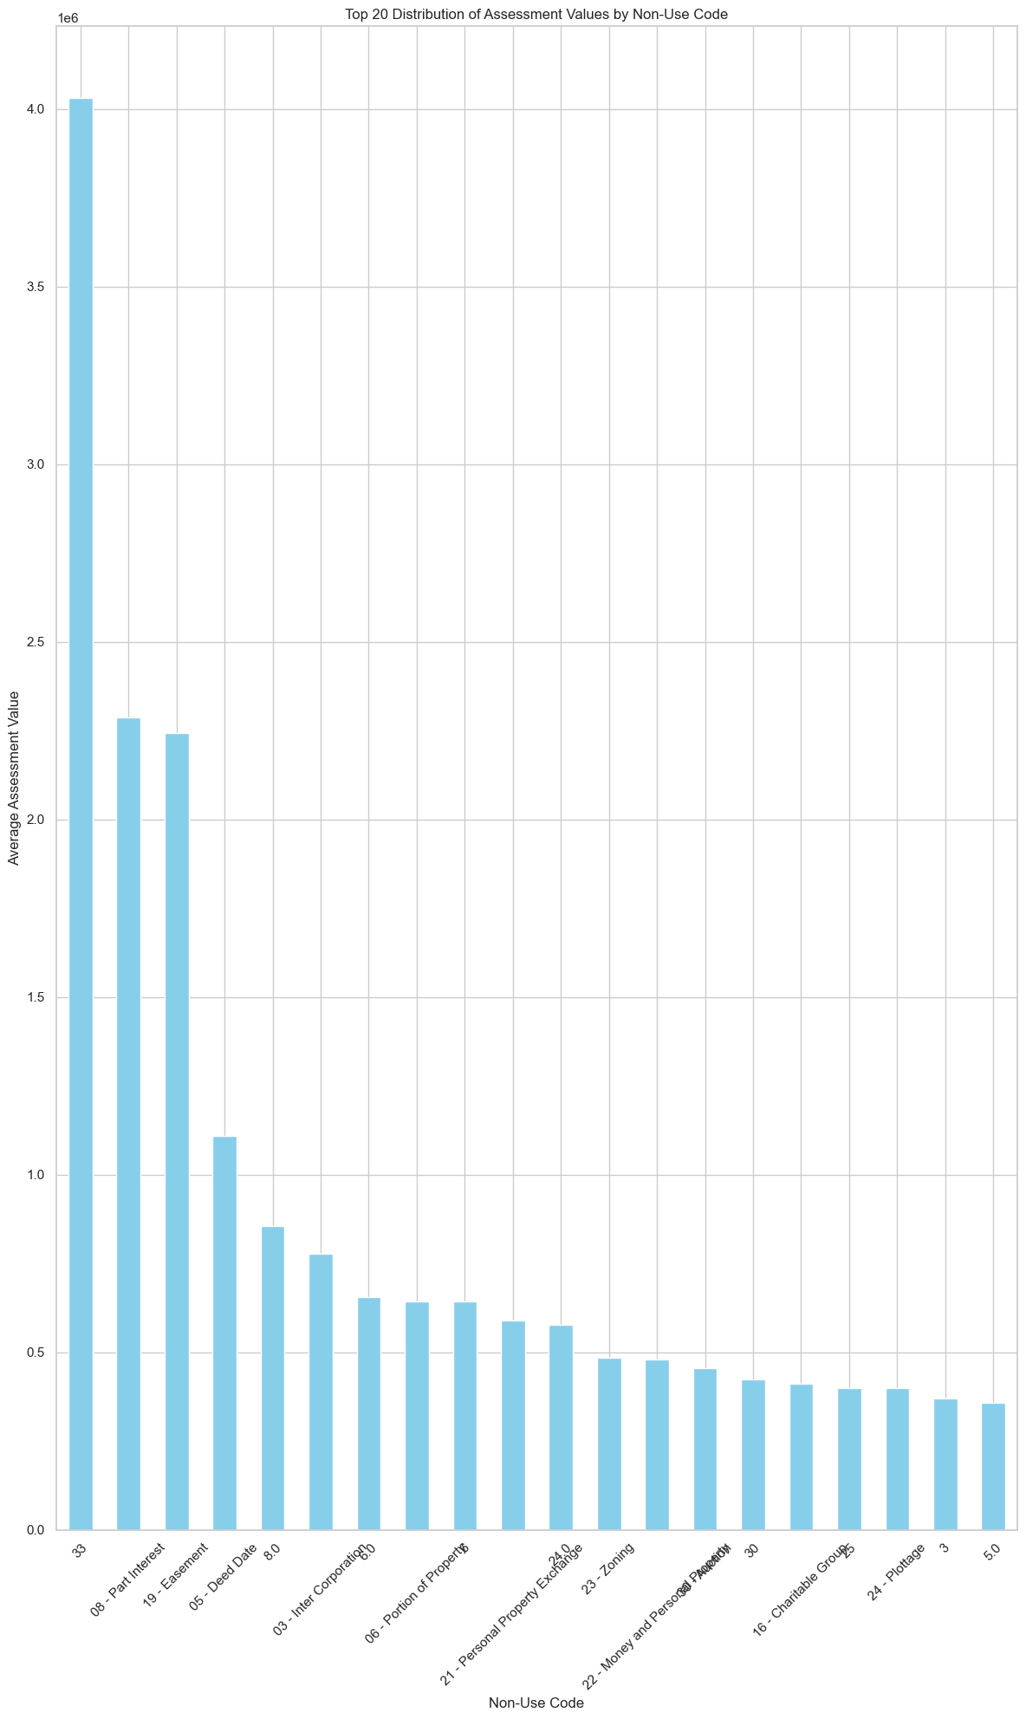
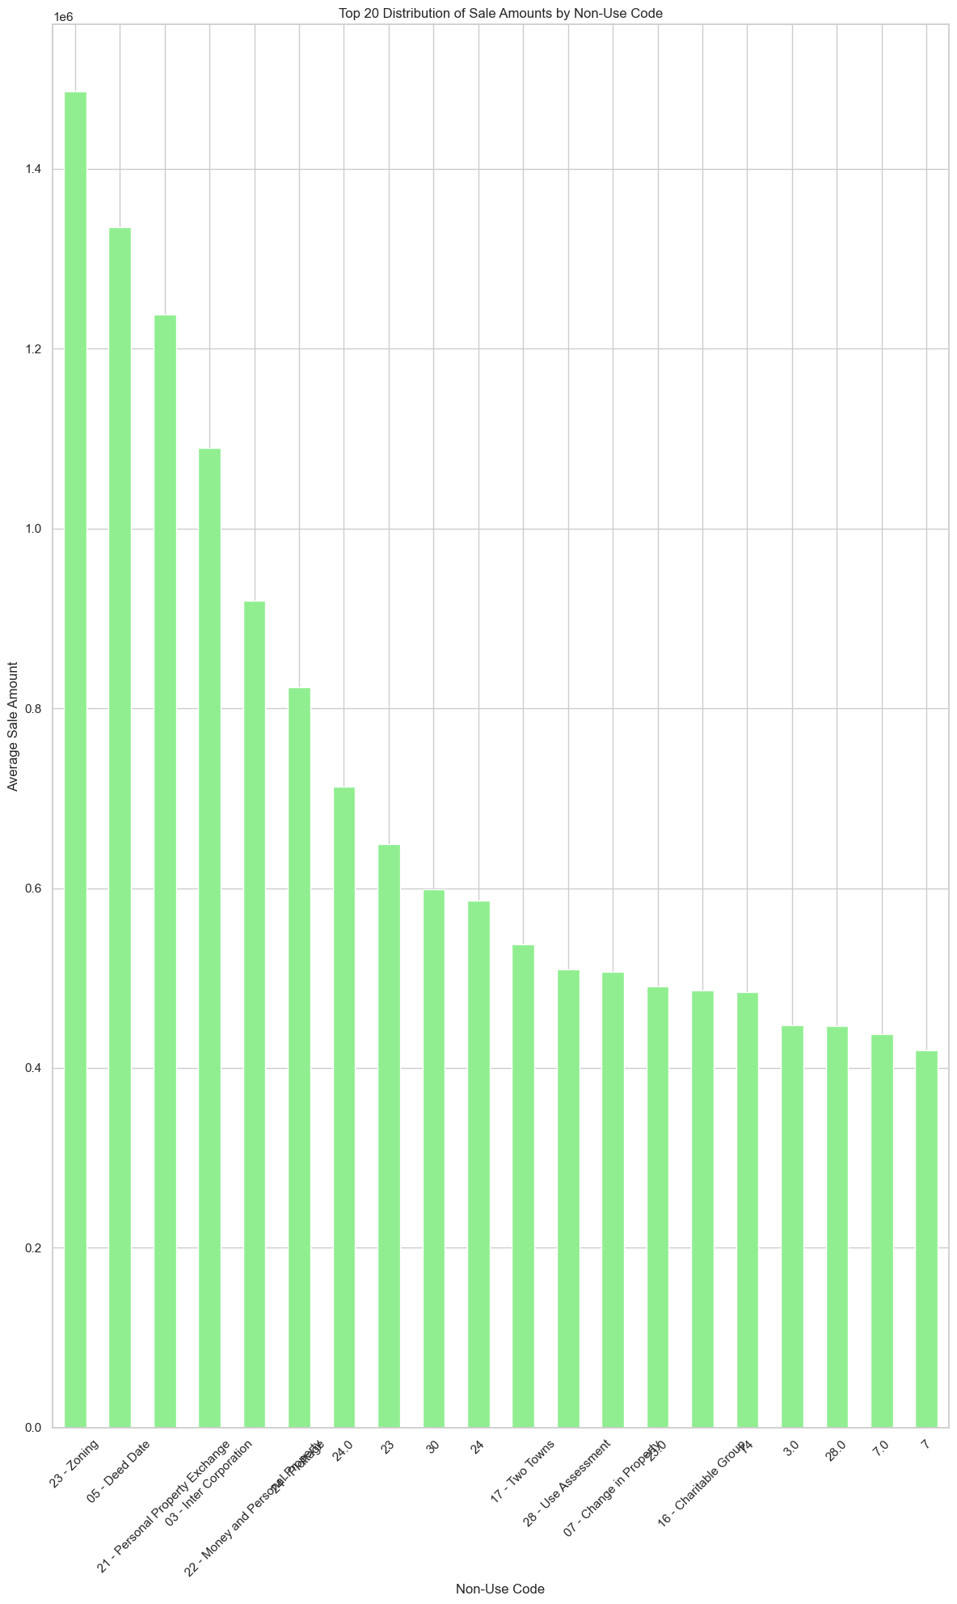

Slide 6
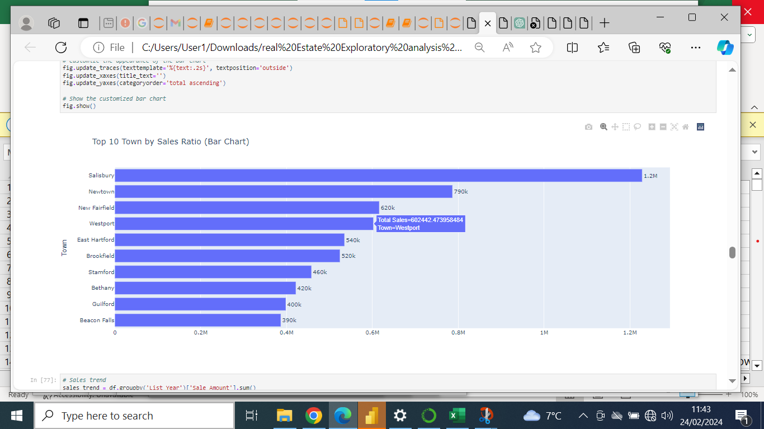
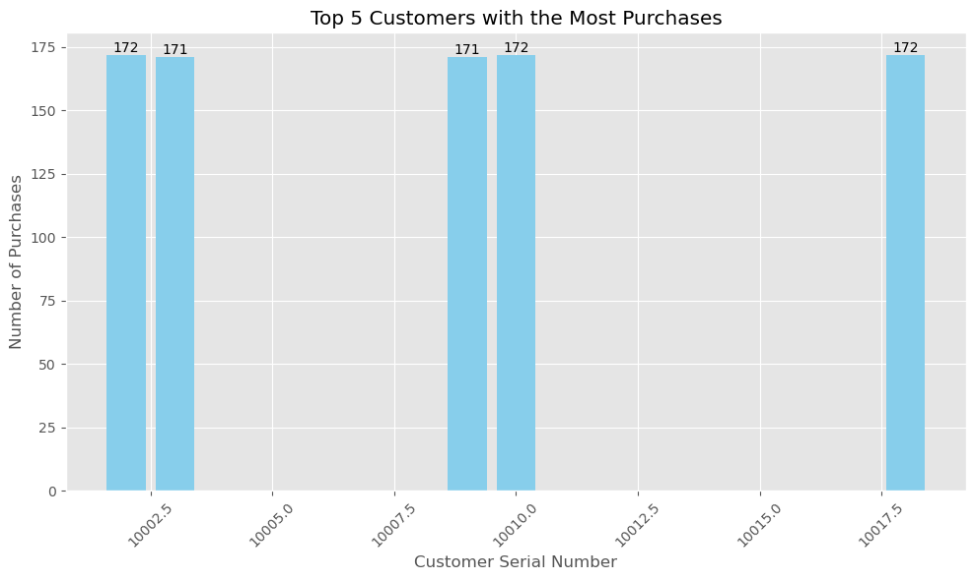
The above chart depicts the top 5 customers who make the most purchases, with each contributing a similar number of purchases ranging from 171 to 172. This consistency implies that these customers exhibit a regular purchasing pattern, which significantly contributes to sales over time.

Slide 7
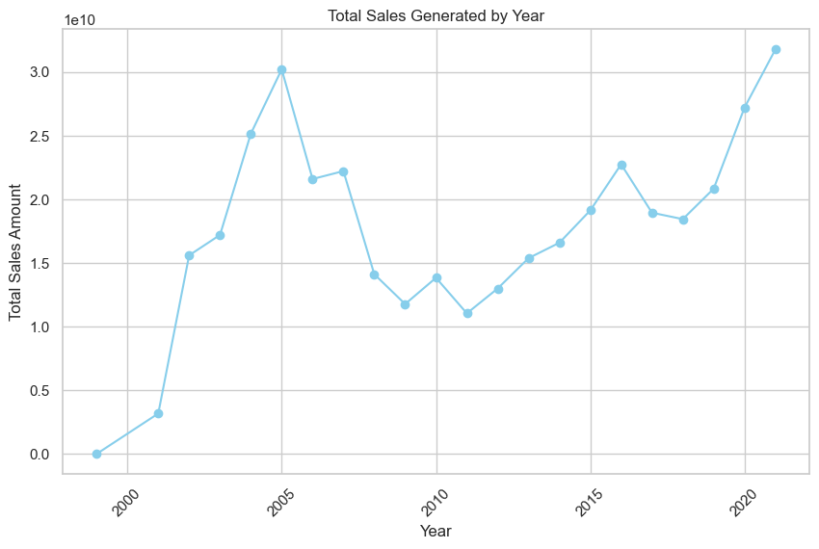
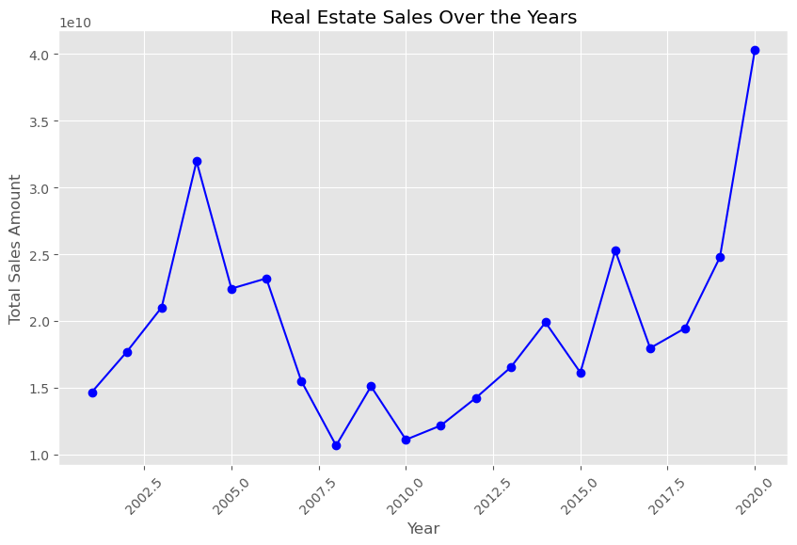

Slide 8
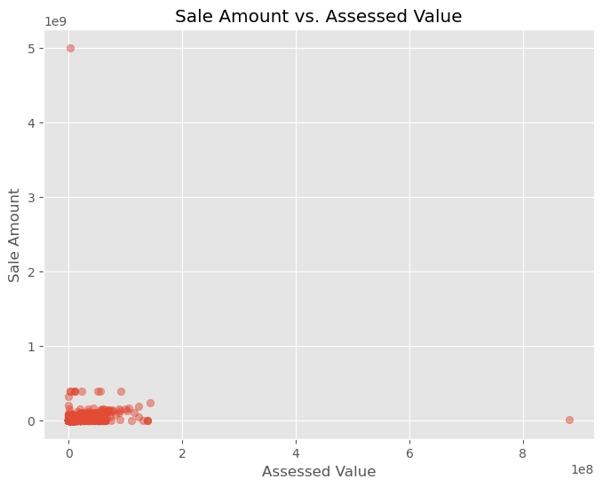
The scatter plot demonstrates the relationship between property assessed values and sale amounts, where each data point represents a property. The Pearson correlation coefficient of 0.1109 indicates a weak positive correlation, with assessed values plotted on the x-axis and sale amounts on the y-axis. Despite a slight positive trend, suggesting that higher assessed values tend to align with higher sale amounts, the correlation coefficient's proximity to zero suggests a weak association. Thus, while there is some connection between assessed values and sale amounts, other factors are likely to have a more significant impact on property sale amounts.

Slide 9
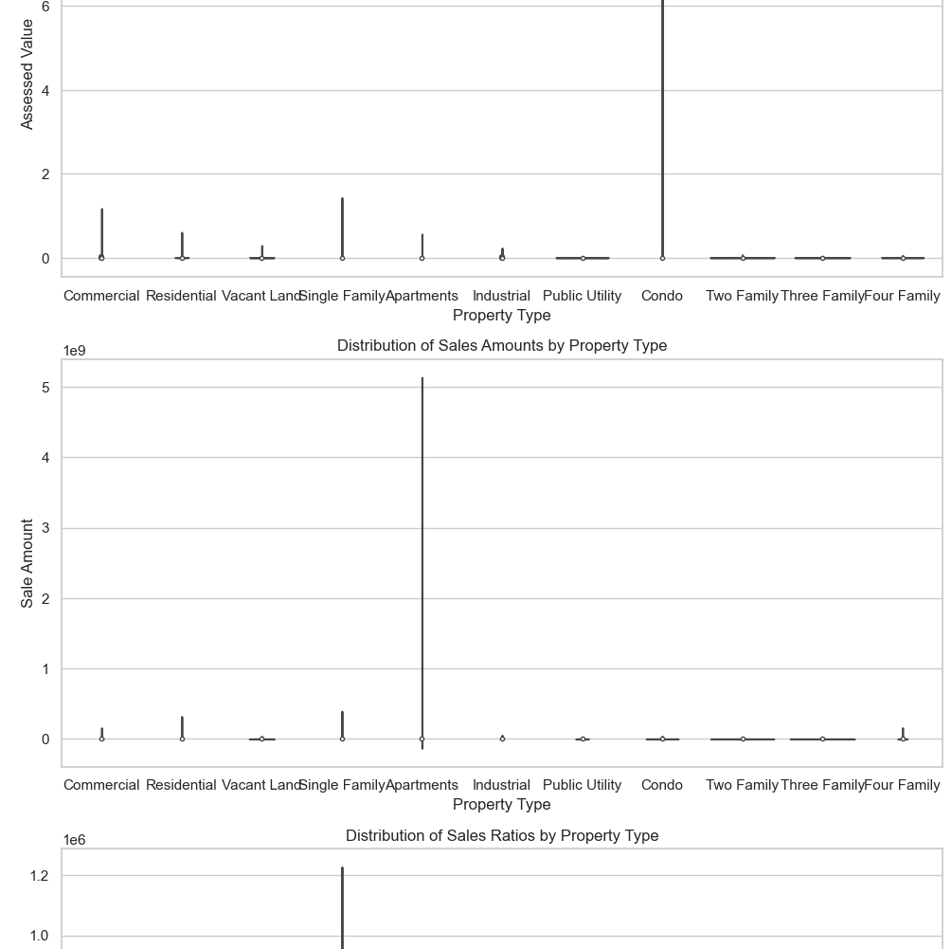
The initial violin plot presents the distribution of assessed values across diverse property types, providing insight into the range and variability within each category. It allows for observing the spread and potential presence of outliers within specific property types.
Following that, the subsequent violin plot demonstrates the distribution of sale amounts among different property types, aiding in comprehending variations in sale amounts and highlighting any significant disparities or similarities.
Lastly, the third violin plot showcases the distribution of sales ratios across property types. The sales ratio, representing the ratio of sale amount to assessed value, acts as a metric for assessment accuracy. This visualization assists in discerning patterns and trends in assessment accuracy across different property types.

Slide 10
FINDINGS
Assessment of Assessed Value vs. Sale Amount: The correlation coefficient between Assessed Value and Sale Amount suggests a weak positive correlation of approximately 0.11. This indicates a slight tendency for higher assessed values to correspond with higher sale amounts. However, the correlation is relatively low, implying that changes in assessed values do not consistently lead to proportional changes in sale amounts.
Evaluation of Assessed Value vs. Sales Ratio: The correlation coefficient between Assessed Value and Sales Ratio lacks direct relevance due to the nature of Sales Ratio as a derived variable. Therefore, the correlation value does not offer meaningful insights into the relationship between assessed values and sales ratios.
Analysis of Sale Amount vs. Sales Ratio: Similarly, the correlation coefficient between Sale Amount and Sales Ratio lacks informativeness owing to the calculation method of the sales ratio. Since the Sales Ratio is computed based on Sale Amount and Assessed Value, it inherently encompasses information from both variables. Hence, the correlation value between Sale Amount and Sales Ratio does not provide valuable insights into their independent relationship.
RECOMMENDATIONS
In summary, the correlation matrix sheds light on the linear associations between numerical columns in the dataset. However, it's crucial to recognize that correlation does not imply causation. Additional analysis may be necessary to grasp the underlying factors influencing the observed correlations.

